Slide 1

V Mobile Presentation
Please use playback speed of 1.25 for every audio.
From Data to Decisions: Optimizing V Mobile's Free Minutes Campaign
October 2025
Presented by
Eddie Mjiyakho

Slide 2
Content
1
Objective & The Problem I Solved
2
Data Sources & My Preparation Steps title
3
My Analysis Process
4
Visual Findings
5
Insights & My Recommendations
6
Next Steps & Thank You
Company Name
Quarter Month
Year

Slide 3
Why the data exist & what questions I am trying to answer?
00%
00%
Year
Year
ROI
Company Name
Quarter Month
Year

Slide 4
Data Sources & My Preparation Steps title:
Building the Foundation: A Single Source of Truth.
Projected
00%
Current
00%
Market reach
Company Name
Quarter Month
Year

Slide 5

A Structured Journey from Raw Data to Strategic Insight.
Analysis Process
Company Name
Quarter Month
Year

Slide 6
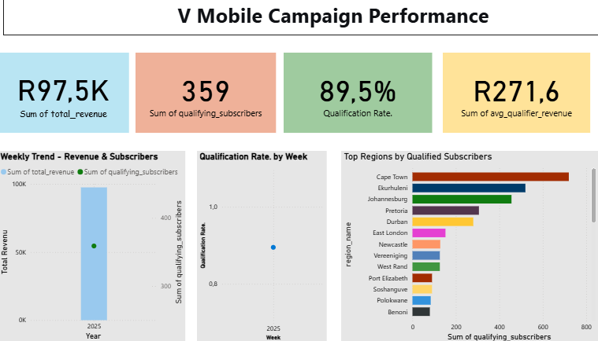
Visual Findings:
The Big Picture.

Slide 7
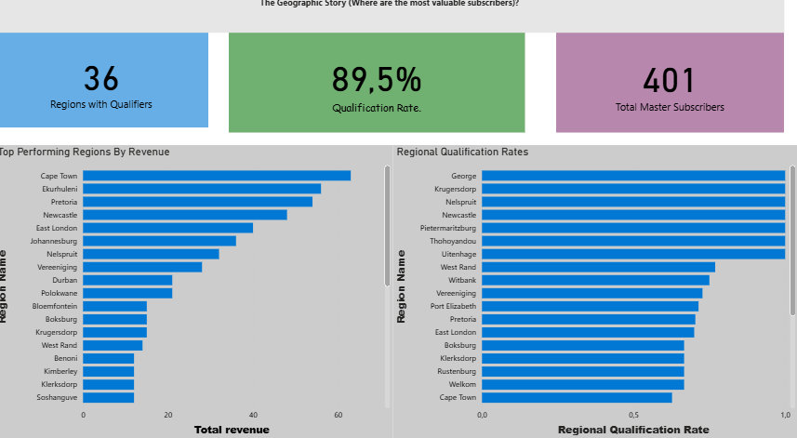
The Geographic Story

Slide 8
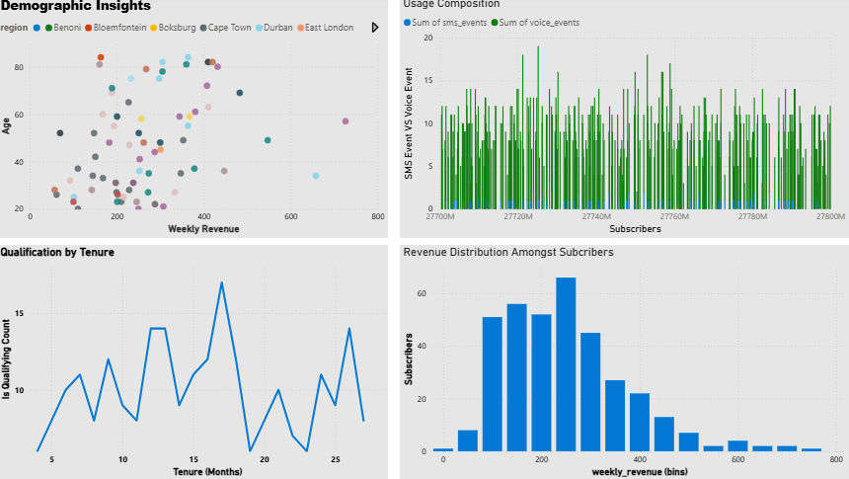
The Subscriber Story
Company Name
Quarter Month
Year

Slide 9

Strategic Recommendations for V Mobile Marketing
Company Name
Quarter Month
Year

Slide 10
The Path Forward
Company Name
Quarter Month
Year

Slide 11
Thank you
Ready for what’s next?
Company Name
Quarter Month
Year

